Slide 1

Day 1 Summary
Kristine Middlemiss, Developer Consultant
Autodesk Developer Network (ADN)

Slide 2
How they all Fit into Maya...
Overlapping Functionality
MEL command docs
C++ API
MEL Scripting
Same class docs
Python command docs
Python API
Python Scripting
Maya Application
Notes:
Methods not supported in Python:
Marked by: NO SCRIPT SUPPORT
In most cases, alternate forms are provided
Devkit examples translated from C++ to Python
Demonstrate how to map features to Python (devkit/plug-ins/scripted)
Discussed using maya.cmds in Script Editor and modules and maya.OpenMaya* in Python scripted plug-ins separately
Same usage distinctions as C++/MEL
With Python, the line between a "script" and a "plug-in" is blurred
Can access maya.OpenMaya* API classes outside of a scripted plug-in

Slide 3
Python API Documentation
No Python-specific API class documentation
Methods not supported in Python:
Marked by: NO SCRIPT SUPPORT
In most cases, alternate forms are provided

Slide 4
Maya’s Python Modules
maya | Top-level module
Maya.cmds | Maya commands (e.g. sphere, getAttr)
maya.utils | Utilities not specific to API or Maya commands
maya.standalone | Initialization routine for standalone Python
maya.OpenMaya* | OpenMaya API modules
maya.app.* | Python code used to implement Maya
maya.test.* | Test scripts

Slide 5
Maya Python API Plug-ins
Several modules were constructed that expose most of the C++ API functionality:
OpenMaya.pyc
OpenMayaAnim.pyc
OpenMayaRender.pyc
OpenMayaUI.pyc
OpenMayaMPx.pyc
OpenMayaCloth.pyc
Notes:
Start of section (2)Maya Python API plugins

Slide 6
Maya Libraries
OpenMaya: fundamental classes for defining nodes and commands and for assembling them into a plug-in
OpenMayaUI: classes necessary for creating new user interface elements such as manipulators, contexts, and locators
OpenMayaAnim: classes for animation, including deformers and inverse kinematics.
OpenMayaFX: classes for Autodesk® Dynamics™
OpenMayaRender: classes for performing rendering functions

Slide 7
OpenMaya Key Points
Parellels C++ libraries, except for maya.OpenMayaMPx
All MPx proxy classes are collected into maya.OpenMayaMPx for technical reasons.
Python API is a thin wrapper around C++ API
Full support of C++ Maya API functionality
SWIG based bindings created from header files
Modules: $MAYA_LOCATION/Python/lib/site-packages/maya

Slide 8
Python Path
PYTHONPATH environment variable
Read when Python initializes
Stored in sys.path
sys.path
Can be modified after Python is initialized

Slide 9
Config File
Create a userConfig.py file and add it to somewhere on your path (PYTHONPATH)
You can add imports and whatever
Changes will show up in top level context
import maya.cmds as cmds

Slide 10
Using Modules
To use a module in your code, use “import”
• “import” adds a module to the namespace of your code
• “import” searches sys.path
• Similar to “include” in C++

Slide 11
Reloading Python plug-ins
Reloading plug-ins allows changing a plug-in without restarting Maya
Process is as follows:
1.load plug-in and test it
2.make changes to the Python code
3.do a File->New to clear scene
4.open Plug-in Manager
5.unload plug-in
6.load plug-in again
7.repeat 1-6 as necessary

Slide 12
Python API vs. C++ API
No MStatus class - use exceptions instead
try:
fnPlugin.registerCommand( “spLs", cmdCreator )
except:
sys.stderr.write( "Command registration failed")
raise
Catch error if registerCommand() fails

Slide 13
Python API vs. C++ API
Detect error but allow code to keep running
try:
fnPlugin.registerCommand( “spLs", cmdCreator )
except:
sys.stderr.write( "Command registration failed")
pass
Keyword pass used instead of raise

Slide 14
Python API vs. C++ API
Python does not have a concept of pointers
Use MScriptUtils for working with pointers and references
Reference treated as a pointer
MScriptUtils
creates objects that can be passed as pointer or reference parameters
convenience methods for transferring values between these objects and native Python datatypes

Slide 15

Maya Architecture Overview
Two vital concepts of Maya architecture
Dependency Graph
Command Architecture

Slide 16
Dependency Graph
Notes:
In a complex Maya scene, this is More like what you’ll end up with

Slide 17
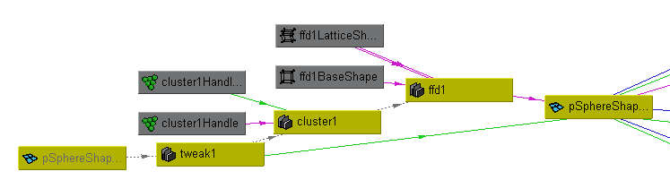
What is the Dependency Graph?

Slide 18
Foundation of Maya File Format
A bunch of MEL commands:
createNode
setAttr
connectAttr

Slide 19



DAG(Directed Acyclic Graph)
DAG nodes are special dependency graph nodes that form a scene hierarchy (parenting).
Car
seats
frame
tires
Notes:
Where to find DAG node: Hypergraph: - DAG
There is a special type of DG nodes, called “DAG”nodes. Define parent-child relationship

Slide 20
What do we need API for?
New Custom Node
Notes:
How to take advantage of DG design and extend Maya’s functionality

Slide 21
What do we need API for?
Custom Maya Command
Maya GUI
Maya Commands
Maya API
Maya Core
OS

Slide 22
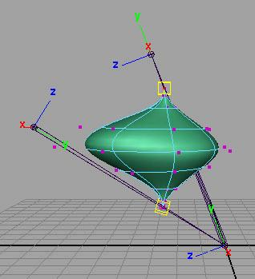

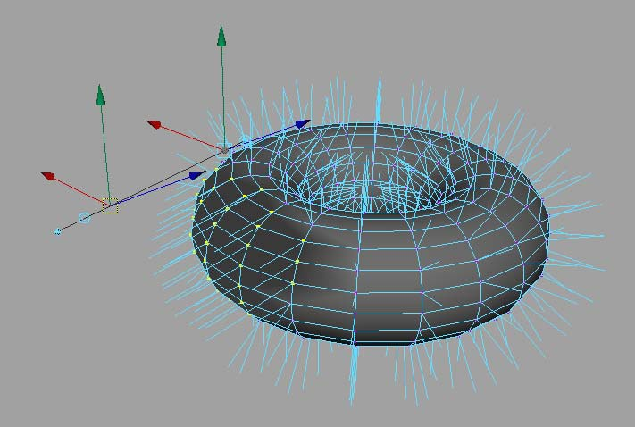
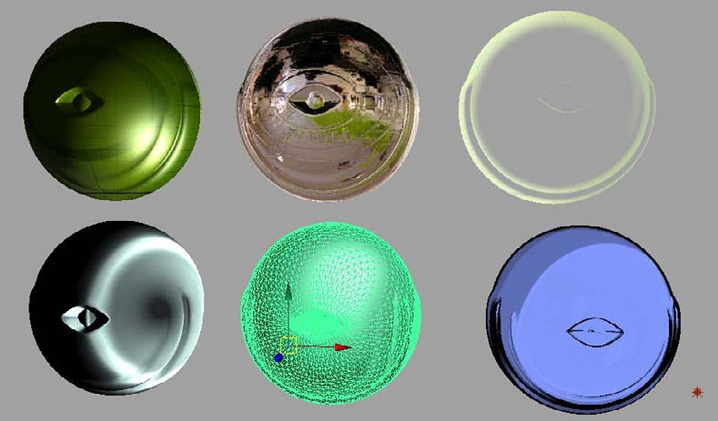
What can you develop using API?
Commands
Dependency Graph Nodes
Deformers
Shaders
Manipulators
Shapes
Etc.
Tools
File Translators

Slide 23
API Design Overview
A tight wrapper around Maya’s internal architecture
An abstract layer, which separates Maya internal code from external plug-in developers
External
developer
Maya API
Maya core
Notes:
One huge benefit of this is that it makes Maya very flexible and extensible,
Also it protects Maya from possible misuse.

Slide 24
Class Categories
Naming Convention | Logical Grouping | Examples
MPx*** | Proxy | MPxCommand MPxNode
MFn*** | Function set | MFnAttribute, MFnDependencyNode
MIt*** | Iterator | MItDependencyNodes, MItMeshEdge
M*** | Wrapper et. al | MObject, MPoint, M3dView

Slide 25
Function Set Classes & MObject
Separate data with functionality
Classical OOP
VS.
Maya Approach
Class A
Data class A
data
Functions Class B
Functions

Slide 26
Function Set Classes
MFnDependencyNode
Base class providing fundamental operators for all dependency nodes
Contains methods to query the name of a node, locate an attribute and parse connections
MFnDagNode
Derived from MFnDependencyNode
Provides methods to query or modify parent/child relationships in the DAG
MFnAttribute
Base class for Maya DG attributes
Offers methods to create an attribute or query/set properties of an attribute on a node

Slide 27
MObject
MObject is the fundamental data type that represents an object in Maya.
Maya API
MObject
Type Information
Pointer to Object
Maya
Internal
Object

Slide 28
MObject
As a pointer to internal objects...
MObjects are not guaranteed to be valid between calls to your plug-in.
It is strongly recommended that you do not hang onto an MObject between calls to your plug-in.
MObjectHandle can be used to test the validity of an MObject.

Slide 29
Iterator Classes
Used to loop over elements of the same type
Iterators start with “MIt”
Some common iterators are
MItDag
MItDependencyGraph
MItMeshEdge
MItMeshVertex
MItMeshPolygon
MItSurfaceCV

Slide 30
Wrapper Classes
Wrapper class exist for simple classes (such as MPoint, MVector, etc…)
Fully implemented C++ classes

Slide 31
Maya Plug-in Architecture
initializePlugin() and uninitializePlugin() as entry point and exit point
Maya API
initializePlugin
uninitializePlugin
Maya
loadPlugin
unloadPlugin

Slide 32
Maya Python Plug-ins
Class Implementation: Similar setup to C++ plug-ins
class scriptedCommand(OpenMayaMPx.MPxCommand):
def __init__(self):
OpenMayaMPx.MPxCommand.__init__(self)
def doIt(self,argList):
print "Hello World!"
Parameter: self same as this in C++

Slide 33
Maya Python Plugins
Load from Plug-in Manager or loadPlugin command
maya.cmds.loadPlugin( "foo.py" )
maya.cmds.unloadPlugin("foo.py" )

Slide 34
Generic Plugin Algorithm
Define initializePlugin and uninitializePlugin functions
Register and unregister the proxy classes (MPxCommand, MPxNode, etc…) within these functions. ie register the custom commands and custom nodes being defined by the plugin
Implement creator and initialize methods (as required) which Maya calls to build the proxy classes
Implement the required functionality of the proxy classes. This requires importing the necessary modules

Slide 35
What does a node do?
Accept input data, compute output data
input attributes
output attributes

Slide 36
API Classes for Attributes
Maya Node
Attributes
MFnAttribute

Slide 37
Attribute Data Types
Basic
Numeric (float, int32,etc.)
String
Matrix
Etc.
Complex
Mesh
NurbsSurface
Generic (accepts more than one type)
Etc.

Slide 38
API Classes for Attributes
Base Class: MFnAttribute
Most Common Used Classes
MFnNumericAttribute
MFnCompoundAttribute
MFnTypedAttribute
MFnMatrixAttribute
MFnGenericAttribute

Slide 39
Attribute Properties – Affects
Attributes can affect other attributes
Once created on a node, an “attributeAffects” relationship can be setup to denote a dependency
D
radius
volume
setAttr D.radius 5
attributeAffects(radius,volume)

Slide 40
MFnAttribute
#- Create a generic attribute using MFnNumericAttribute
nAttr = OpenMaya.MFnNumericAttribute()
transCircleNode.input = nAttr.create( "input", "in", OpenMaya.MFnNumericData.kDouble, 0.0 )
#- Attribute will be written to files when this type of node is stored
nAttr.setStorable(1)
#- Create individual input translate attributes
transCircleNode.inputTranslateX = nAttr.create( "inputTranslateX", "itX", OpenMaya.MFnNumericData.kDouble, 0.0 )
nAttr.setStorable(1)
transCircleNode.inputTranslateY = nAttr.create( "inputTranslateY", "itY", OpenMaya.MFnNumericData.kDouble, 0.0 )
nAttr.setStorable(1)
transCircleNode.inputTranslateZ = nAttr.create( "inputTranslateZ", "itZ", OpenMaya.MFnNumericData.kDouble, 0.0 )
nAttr.setStorable(1)
#- Create compound input translate attributes and add individual input translate attributes
comAttr = OpenMaya.MFnCompoundAttribute()
transCircleNode.inputTranslate = comAttr.create("inputTranslate","it")
comAttr.addChild(transCircleNode.inputTranslateX)
comAttr.addChild(transCircleNode.inputTranslateY)
comAttr.addChild(transCircleNode.inputTranslateZ)
comAttr.setStorable(1)
Base of attribute function set classes
Take care of all the common aspect of an attribute on node
Readable/writable
Connectable
Storable
Keyable
Dynamic

Slide 41
API Classes for Plugs
Maya Node
Maya Node
Attributes
Plugs
MFnAttribute
MPlug

Slide 42
Plugs
Plugs can be used to:
query a value
set a value
create a connection
remove a connection
query connection(s)
Does not store attribute data

Slide 43
API Class for Plug: MPlug
Attribute and Node Operations:
MPlug::MPlug (const MObject &node, const MObject &attribute)
MObject MPlug::attribute ( MStatus * ReturnStatus)
MObject MPlug::node ( MStatus * ReturnStatus)
Operations for Compound Attribute and Connections:
MPlug MPlug::parent ( MStatus * ReturnStatus)
MPlug MPlug::child (unsigned int index, MStatus *ReturnStatus)
bool MPlug::connectedTo ( MPlugArray & array, bool asDst, bool asSrc, MStatus * ReturnStatus = NULL )
Manipulation of Data
MStatus MPlug::getValue ( double & val, MDGContext & ctx )
MStatus MPlug::setValue ( double val )

Slide 44
Creator Function
Proxy Classes and Object Ownership:
When creating a proxy class in a creator() function or any other function that returns the class to Maya, you must call OpenMayaMPx.asMPxPtr() on the new object.
This call transfers ownership of the object to Maya.
If this call is not made, then Python retains ownership and can dereference the object and destroy it even though Maya may have a pointer to it.
This module contains the bindings for any proxy or MPx class we provide

Slide 45
Undo: Plug-in VS Script
Undo
It is possible to mix Maya Python API calls along with Maya command calls in the same script.
Undoing the operations of such a script will not be correct if the Maya Python API calls modify the model and do not properly support undo using the MPxCommand class.

Slide 46
Q & A

Slide 47
Autodesk

